Slide 1
Multilevel Modeling
Amy Garrison, Kelsey Timme, Amina Mamane Sanoussi

Slide 2
Background Information
The multilevel model is a design where the data parameters vary at more than one level.
The lower level tends to be data on individuals, while higher levels are groups of the individuals used in the lower level.
The dependent variable is examined at the lowest level.
Two level models are the most common, but there can be many more levels in the analysis.
This method can be used for prediction, data reduction, and causal inference in multi-grouped data sets.

Slide 3
Why Use Multilevel Modeling?
Observations of a group of individuals can be biased due to interconnection of characteristics within the group
Better estimate of standard errors of regression
The extent of effects due to ‘groups’ on individual outcomes

Slide 4
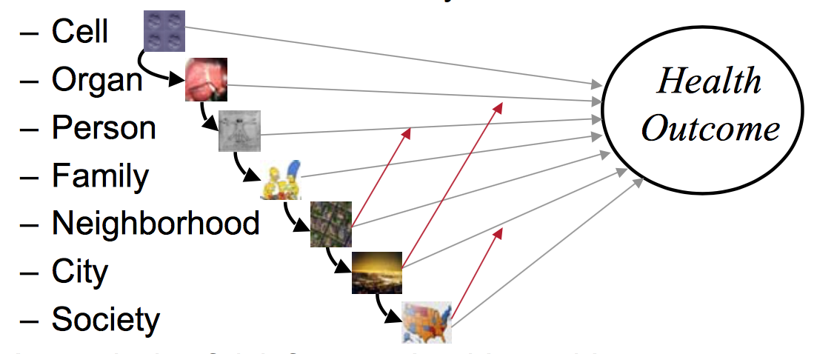
Examples of Multilevel Modeling
Health can be dependent on the cell -> organ -> person -> family -> society
Quality of care of patients -> hospitals
Learning of children -> classrooms -> schools
Used in biology, geography, education...
http://www.biostat.jhsph.edu/

Slide 5
Assumptions
Data follows a normal distribution
X’s are fixed and known
All covariates are included in the model
Homogeneity of variance

Slide 6
Level 1 Regression equation
Y_{ij} = β_{0j} + β_{1j}X_{ij} + e_{ij}
Y_{ij} : result on the dependent variable for an individual observation. i (individual) j (group)
X_{ij} : level 1 predictor
β_{0j} : intercept of the dependent variable in group j
β_{1j} : slope for the relationship in group j between level 1 predictor and dependent variable
e_{ij} : random errors
Depends on number of individual observations

Slide 7
Level 2 Regression Equation
β_{0j} = γ₀₀ + γ₀₁W_{j} + µ_{0j}
β_{1j} = γ₁₀ + µ_{1j}
γ₀₀ : overall intercept
W_{j} : level 2 predictor
γ₀₁ : overall regression coefficient between dependent variable and level 2 predictor
µ_{0j} : random error for deviation of intercept
γ₁₀ : overall regression coefficient between dependent variable and level 1 predictor
µ_{1j} : error for slope
Depends on number of groups

Slide 8
Statistical Test and Power
Statistical tests: Z-test or t-test.
Statistical power: level 1 depends on number of individual observations, while level 2 depends on number of groups.
Having a large number of groups is more important than a large number of individuals.

Slide 9
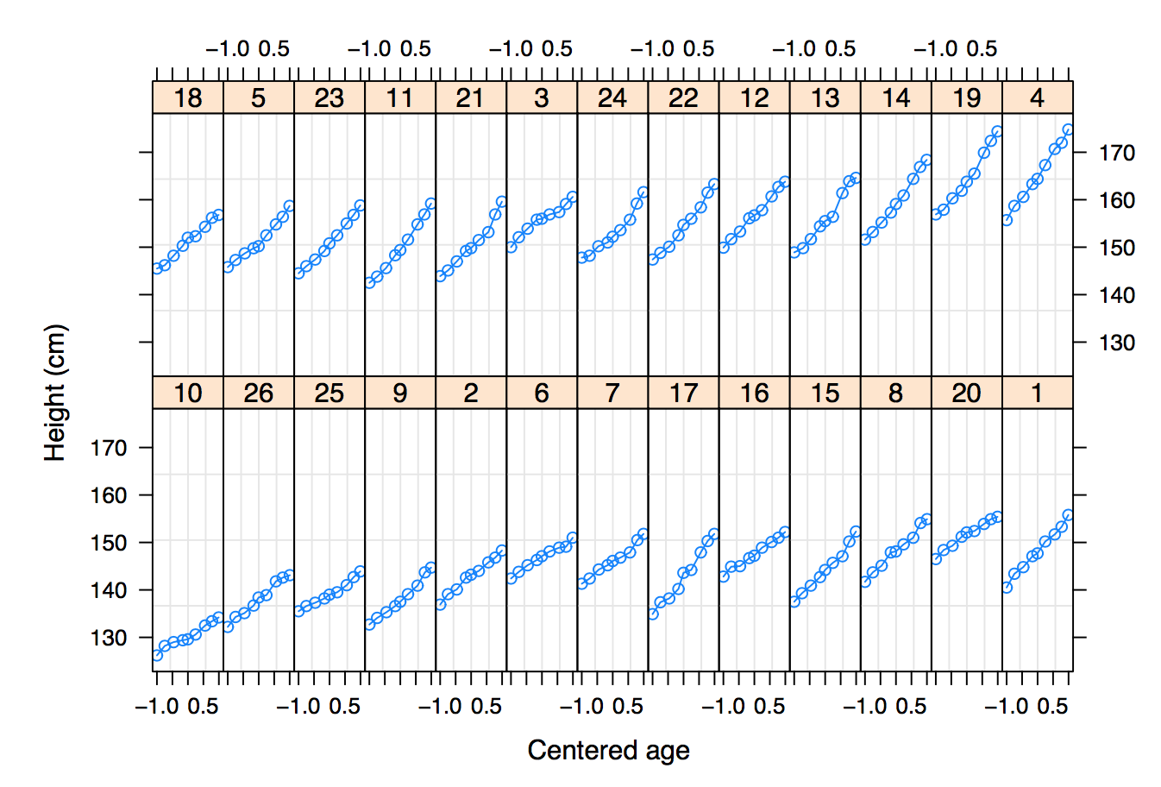
Example Problem
Looking at the growing pattern of 26 Boys in Oxford, England.
Height measurements were taken 9 times
Pinheiro and Bates (2000)

Slide 10
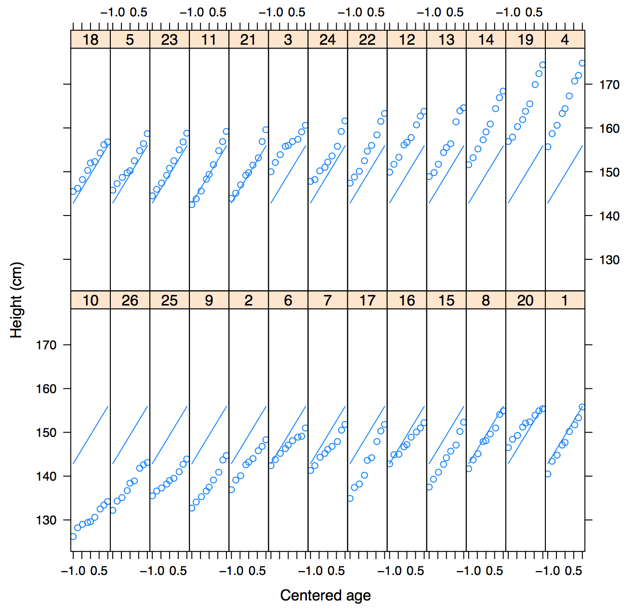
Example Problem
Attempt to model using Simple Linear Regression Model
H = β₀+β₁A+ε
H = height
A= age
ε= error
Buxton, 2008

Slide 11
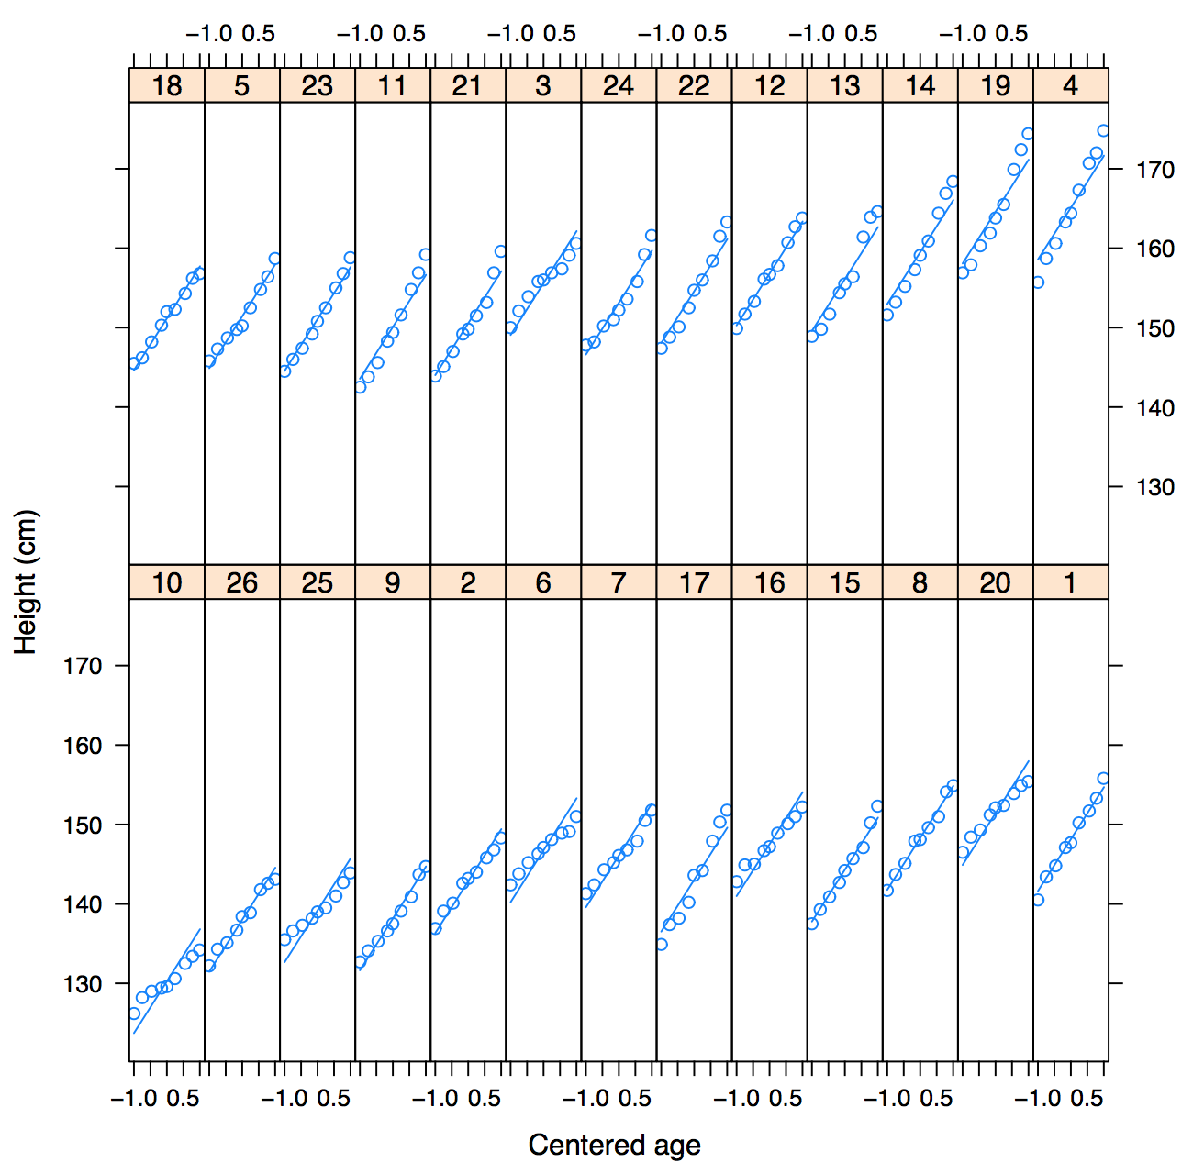
Example Problem
Need to allow intercept to be different between subjects
H_{ij} = β_{0j}+β₁A_{ij}+ε_{ij}
Β_{0j} = β₀ +μ_{0j}
Where μ_{0j} ~ N(0, 𝒯₀)
H_{ij} = (β₀ + μ_{oj}) + β₁A_{ij} + ε_{ij}
Buxton, 2008

Slide 12
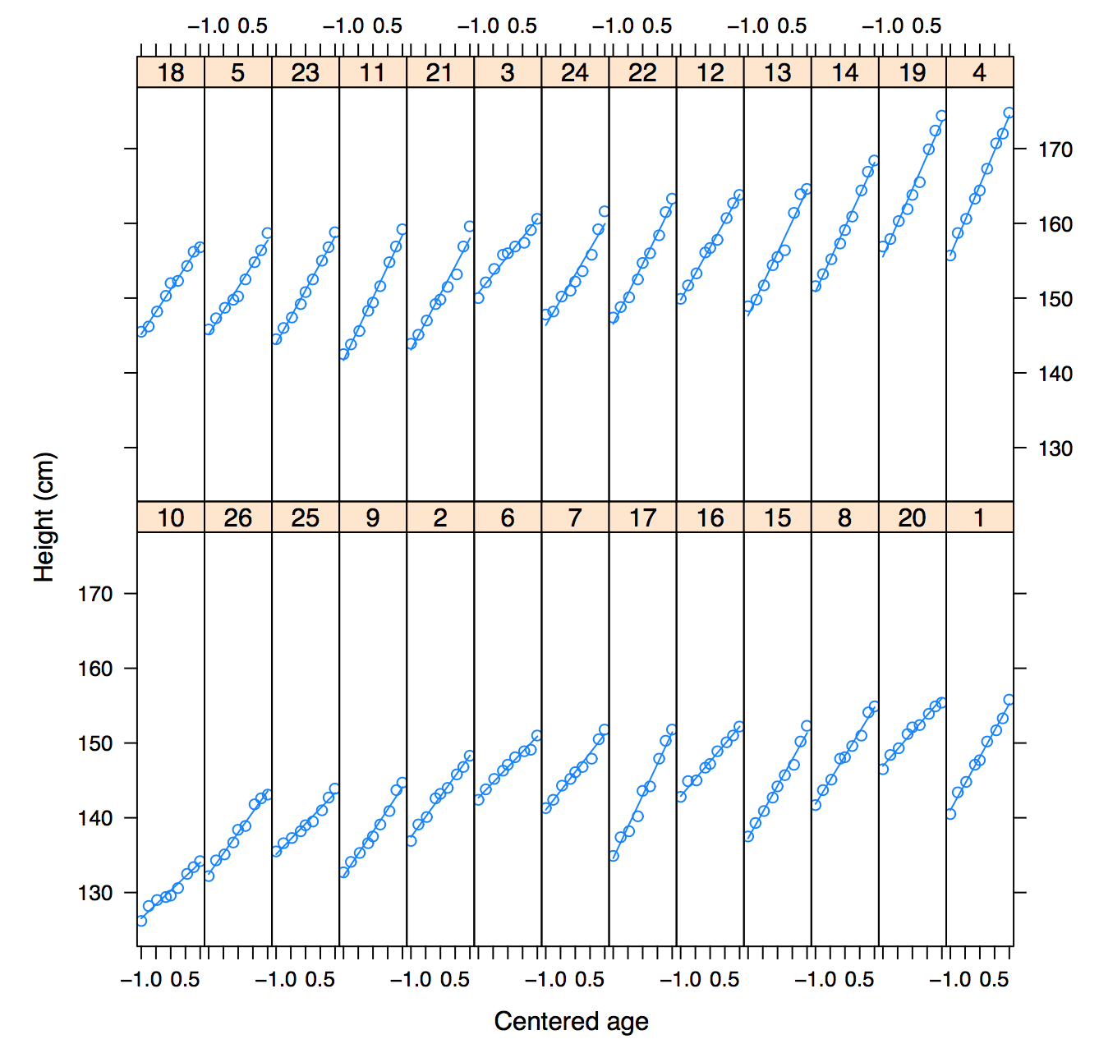
Example Problem
Need to allow slope to be different between subjects
β₁ = β₁ + μ_{1j}
H_{ij} = (β₀ + μ_{oj}) + (β₁ + μ_{1j})A_{ij} + ε_{ij}
Buxton, 2008

Slide 13
Multilevel Modeling Vs Simple Linear Regression
Multilevel Model has two random variables
Measurement level random variable, ε_{ij}
Subject level random variable, μ_{oj}
These random variables help give a better fit model that account for the variation between groups.
Use of Multilevel Modeling can be generalized to a wider population, contain fewer parameters, and information can be shared within groups

Slide 14
Conclusion
The multilevel model is used to account for various connected factors that could influence the observations in a data set
As well as ascertain which of the factors are responsible for changes in the data

Slide 15
References
Buxton, R. (2008). Statistics: multilevel modeling. Mathematics Learning Support Centre.
Pinheiro, J.C. & Bates, D.M. (2000). Mixed-effects models in S and S-PLUS. Springer.
Gelman, A. (2006). Multilevel (Hierarchical) Modeling. Columbia University
Introduction to Multi-Level Models. http://www.biostat.jhsph.edu/~fdominic/teaching/bio656/lectures/1.intro.pdf
(2002). What are Multilevel Models and Why Should I Use Them? THe University of Bristol.

